Slide 1
Intellectual Property and the Web
Craig Knoblock
University of Southern California
Craig Knoblock

Slide 2
Some (Hypothetical) Cases
Slide courtesy of Kristina Lerman
Abby wants a pretty image for her blog. She found one on Flickr. Can she use it on her blog?
Ben notices many students wearing USC apparel. He decides to take USC logos off the web, stick them on cheap t-shirts and make some extra $$. Can he legally do this?
Can Carlos post class notes he took on his web site?
Donna posted a video of her baby dancing to a Prince song. Can Prince’s record company demand that it be removed?
Eddie really likes the movie he rented from Netflix, and wants to rip it to his computer. He finds ripping instructions online. Is he legally able to do this? Can the website legally offer instructions?

Slide 3
Intellectual Property
Intellectual property (IP) is an intangible creative work
It is not the physical form on which it is stored or delivered
IP can be protected through the use of
patents,
copyrights,
trademarks, and
trade secret laws
Craig Knoblock

Slide 4
Sources
US Patent and Trademark Office
www.uspto.gov
Scrape It, Scrub It and Show It: The Battle Over Data Aggregation
http://web.archive.org/web/20070818130311/http:/www.ffhsj.com/bancmail/bmarts/aba_art.htm
Intellectual Property Law, Freedom of Expression, and the Web, K. McLeod
http://www.electronicbookreview.com/thread/technocapitalism/proprietary
Electronic Frontier Foundation -
http://www.eff.org/issues/intellectual-property
Craig Knoblock
Notes:
A Gift of Fire: Social, Legal, and Ethical Issues for Computers and the Internet, 2nd Edition by Sara Baase
PowerPoint slides created by Sherry Clark

Slide 5
Outline
Patents
Copyrights
Trademarks
Trade Secrets
Data Aggregation
Software Licenses
Craig Knoblock

Slide 6
Outline
Patents
Copyrights
Trademarks
Trade Secrets
Data Aggregation
Software Licenses
Craig Knoblock

Slide 7
Patents
PATENTS provide rights for up to 20 years for inventions in three broad categories:
Utility patents protect useful processes, machines, articles of manufacture, and compositions of matter
Some examples: fiber optics, computer hardware, medications.
Design patents guard the unauthorized use of new, original, and ornamental designs for articles of manufacture
The look of an athletic shoe, a bicycle helmet, the Star Wars characters are all protected by design patents
Plant patents are the way we protect invented or discovered, asexually reproduced plant varieties
Hybrid tea roses, Silver Queen corn, Better Boy tomatoes are all types of plant patents
Craig Knoblock

Slide 8
What Can Be Patented
Any person who “invents or discovers any new and useful process, machine, manufacture, or composition of matter, or any new and useful improvement thereof, may obtain a patent,”
This covers practically everything that is made by man and the processes for making the products
The patent law specifies that the subject matter must be “useful.”
Refers to the condition that the subject matter has a useful purpose
A machine which will not operate to perform the intended purpose would not be called useful
Laws of nature, physical phenomena, and abstract ideas are not patentable
A patent cannot be obtained upon a mere idea or suggestion.
A complete description of the actual machine or other subject is sought is required
Craig Knoblock

Slide 9
Novelty And Non-Obviousness, Conditions For Obtaining A Patent
In order for an invention to be patentable it must be new
An invention cannot be patented if:
If the invention has been described in a printed publication before the date that the applicant made his/her invention
If the inventor describes the invention in a printed publication or uses the invention publicly and more than one year has gone by
The inventor must file on the date of public use or disclosure to preserve patent rights in foreign countries
The subject matter to be patented must be sufficiently different from what has been used or described before
It may be said to be nonobvious to a person having ordinary skill in the area
For example, the substitution of one color for another, or changes in size, are ordinarily not patentable.
Craig Knoblock

Slide 10
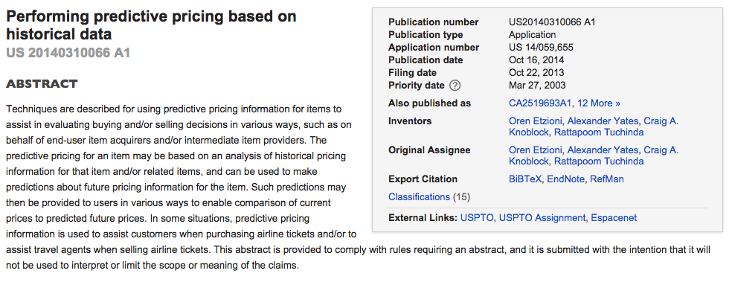
Example Patent Abstract / Inventors

Slide 11
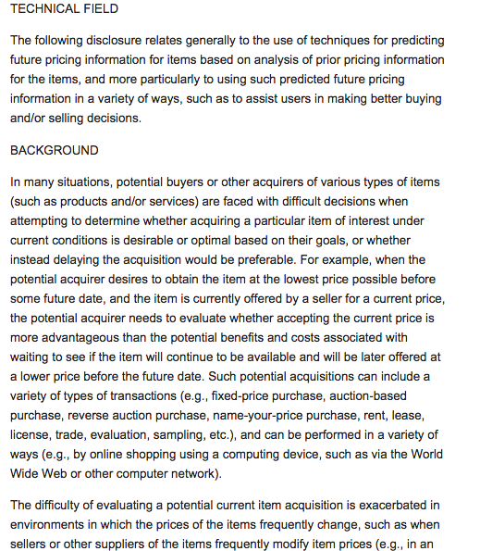
Example Patent Description

Slide 12
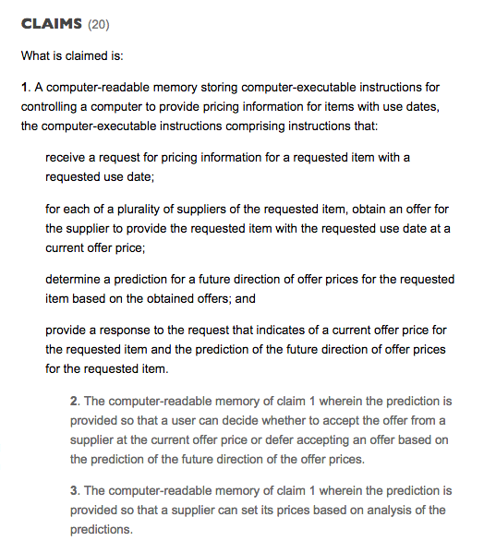
Example Patent Claims

Slide 13
Why Patent?
Benefits to the inventor
Gives owner exclusive right to make, use, sell, the patented invention
For a limited term only (20 years)
Provides economic incentive for research and development
Inventor is not required to patent invention
Coca Cola’s formula was never patented (trade secret)
Benefits to society
Disclose invention to the public
Allows others to improve on the original invention
Slide courtesy of Kristina Lerman

Slide 14
Patent Infringement
Two ways to defend against a patent lawsuit
Invalidity
Show that the prior art exists prior to the actual patent
Single patent that covers all of the claims
Combination of patents and it would have been obvious to put them together
Noninfringement
Show that the accused work does not implement exactly what is claimed in the patent

Slide 15
Outline
Patents
Copyrights
Trademarks
Trade Secrets
Data Aggregation
Software Licenses
Craig Knoblock

Slide 16
Copyrights
COPYRIGHTS protect works of authorship, such as writings, music, and works of art that have been tangibly expressed.
The Library of Congress registers copyrights which last the life of the author plus 70 years
Books, albums, movies are all copyrighted
You don't even have to register it with the U.S. Copyright Office
You cannot copyright facts, such as the information in the telephone book
But you can copyright the particular presentation of those facts
Craig Knoblock
Notes:
Copyright protects an original expression as soon as it's in tangible form.

Slide 17
Copyrights
Copyright owners have the exclusive right to:
Make copies of the work
Produce derivative works
Distribute copies
Perform the work in public
Display the work in public
Craig Knoblock

Slide 18
Copyright and the Consumer
As a consumer, you cannot legally
Copy the work: online media too, such as images, music, movies, etc.
Create derivative works
Distribute copies: burn a few CDs and sell them or give them away
Perform a work in public: unless you pay royalty
Display the work in public
Slide courtesy of Kristina Lerman

Slide 19
U.S. Copyright Law History
1790: First U.S. copyright law; covered printed material. Later, newer technologies (photography, sound recordings, etc.) were added
1909: Definition of unauthorized copy formed
1960s: Some software and databases receive protection
1992: Making copies for personal gain became a felony
1997: Illegal to make copies regardless of financial gain
1998: Illegal to circumvent copy protection schemes
1998: After heavy lobbying by Disney, Congress extends copyright term by 20 years
Craig Knoblock
Notes:
Congress shall have the power to... promote the progress of science and useful arts, by securing for limited times to authors and inventors the exclusive right to their respective writings and discoveries" (US Const., art I. sec. 8, cl. 8.).

Slide 20
Limits to Copyright: Fair-Use
Under certain circumstances, permission to use a work is not required
Fair-Use Doctrine: factors to be considered
The purpose and character of the work
The nature of the copyrighted work
The amount and substantiality of the portion used in relation to the copyrighted work
The effect on the potential market for or value of the copyrighted work
Slide courtesy of Kristina Lerman

Slide 21
Fair-Use Doctrine
Allows the use of copyrighted material that contribute to the creation of new works
The new works cannot significantly affect sales of the source material, thus depriving copyright holders of their income
Allows use for some research and educational purposes
Allows use for news reporting and critiquing
Craig Knoblock

Slide 22
Copyright Law
Fair-Use Cases
Sony vs. Universal City Studios
1984: U.S. Supreme Court ruled that non-commercial copying of a movie for viewing at a later time was fair use
Court ruled that copying devices (e.g., Betamax VCR) should not be banned if they have significant legal uses
Sega Enterprises vs. Accolade
1992: Reverse engineering a complete program in order to produce new, creative work was ruled as fair use
Craig Knoblock

Slide 23
More Fair-Use Cases
Kelly v. Arriba Soft Corporation
2003: Appeals court ruled that use of thumbnail images and inline linking in search engine results do not violate copyright since thumbnails are “highly transformative”
Also applies to Google quoting portions of web pages in search results
Online copyright policing
2008: Court ruled that copyright holders cannot order a deletion of an online file without first determining that it reflects “fair use” of the copyrighted work
Case involved a mom posting a video on YouTube of her baby dancing to a Prince song
Universal Music, copyright owner, ordered YouTube to remove the video
Mom sued Universal Music for her legal costs
Slide courtesy of Kristina Lerman

Slide 24
Google Books
Google’s goal is to scan all books and provide search capabilities
~130 million books, ~30 million scanned (so far)
Most books out-of-print
Google books library project
Many libraries allowing Google to scan their book
Copyright infringement lawsuit/settlement
2005 Sep: Authors Guild sues Google
2008 Oct: $125M settlement
Opt-out clause for out-of-print works, orphan books
Authors get: 63% of all associated revenues, $60 per scanned book
Google gets to:
index the books and display snippets in search resultsshow ads on these pages and
make available for sale digital versions of each book.
2011 Mar: Judge rejects settlement:
“would grant Google significant rights to exploit entire books, without permission of the copyright owners".
2013 Nov: District court sides with Google citing fair use, authors appeal…
Slide courtesy of Kristina Lerman

Slide 25
Public Domain
Works in the public domain are not covered by IP rights
Works not covered by copyright law
Ideas (e.g., mathematical formulas)
Works pre-dating copyright law (e.g., Bible)
Expired copyright
E.g., novels of Jane Austen
Government works
Traditional knowledge, folklore
Slide courtesy of Kristina Lerman

Slide 26




Creative Commons (CC)
Original CC licenses
Attribution: Licensees may copy, distribute, display and perform the work only if they give owner the credits
Noncommercial: Licensees may copy, distribute, etc. the work only for noncommercial purpose
No Derivative Works: Licensees may copy, distribute, etc. the work, not derivatives based on it.
ShareAlike: Licensees may distribute derivative works only under a license identical to the license that governs the original work.
Some content online is CC
Slide courtesy of Kristina Lerman

Slide 27
Outline
Patents
Copyrights
Trademarks
Trade Secrets
Data Aggregation
Software Licenses
Craig Knoblock

Slide 28
Trademarks
TRADEMARKS protect words, names, symbols, sounds, or colors that distinguish goods and services from other manufacturer’s products
Trademarks, unlike patents, can be renewed forever as long as they are being used in business.
The roar of the MGM lion, the pink of the Owens-Corning insulation, and the shape of a Coca-Cola bottle are familiar trademarks.
No Fair-Use provision in Trademark law
Craig Knoblock

Slide 29
Types of Trademarks
™
unregistered trade mark used to promote or brand goods
℠
unregistered service mark used to promote or brand services
®
registered trademark
Slide courtesy of Kristina Lerman

Slide 30
Trademarks and the Internet
Companies use trademark & copyright law to silence criticism online
Court ruled in favor of Church of Scientology in its dispute with church dissidents
Domain names
Courts ruled in favor of trademark-owners in “cyber-squatting” cases.
1999 Congress passed a law with penalties up to $100k for people who use trademarked names in their domain names (e.g., "CokeSucks.com“)
Slide courtesy of Kristina Lerman

Slide 31
Outline
Patents
Copyrights
Trademarks
Trade Secrets
Data Aggregation
Software Licenses
Craig Knoblock

Slide 32

Trade Secrets
TRADE SECRETS are information that companies keep secret to give them an advantage over their competitors
The formula for Coca-Cola is one of the most famous trade secrets
Craig Knoblock

Slide 33
Legal Protection of Trade Secrets
Treated by law as confidential information
Must be protected by non-disclosure agreement (NDA) or non-compete contracts
Gives owner perpetual monopoly on secret information
Does not expire like a patent
Slide courtesy of Kristina Lerman

Slide 34
Outline
Patents
Copyrights
Trademarks
Trade Secrets
Data Aggregation
Software Licenses
Craig Knoblock

Slide 35
Data Aggregation
Data aggregation, aka “screen scraping” or “wrapping” is conducted widely today
Some of it is on sound legal ground
Business to business sharing of data
Partnerships where organizations agree to share the information on their web sites
Data aggregation within an organization
Aggregation of public information
Aggregation of facts
but some it is has more ambiguous legal standing
News aggregation (e.g., Google News)
Auction aggregation (e.g., Ebay vs. BiddersEdge)
Deep linking (e.g., Microsoft vs. Ticketmaster)
Craig Knoblock

Slide 36
First Union vs. Secure Commerce Services
Companies such as VerticalOne, Yodlee, and Secure Commerce Services provide aggregation of account information for customers
Dec 30, 1999, First Union Bank filed a complaint against SCS over the Paytrust Smartbalance feature
Alleged “unauthorized access to a computer, trademark and copyright infringement, misrepresenting its relationship with First Union and misleading customers.”
Feb 28, 2000, First Union drops the legal action against SCS since SCS agreed to meet First Union’s Internet Aggregation standards
Craig Knoblock

Slide 37
eBay vs. Reverse Auction
Jan 2000, Ebay filed suite against Reverse Auction, Inc.
Reverse auction would copy eBay’s users’ email addresses, user id’s and feedback ratings
Then they sent the users email falsely warning that their eBay id would expire soon
They offered to let them use their id and feedback rating on the Reverse Auction website
The Federal Trade Commission also brought an action against RevereAuction for unfair and deceptive aspects of the ReverseAuction operation
Craig Knoblock

Slide 38
Ebay vs. BiddersEdge, Inc
Jan 2000, Ebay also brought suite against BiddersEdge, Inc.
BiddersEdge aggregated auctions from multiple auction sites and then linked users to do the bidding on the individual sites
Claims against BiddersEdge included
Trespass to personal property for interference with Ebay’s computer systems
Violation of the Computer Fraud and Abuse Act for unauthorized access to a protected computer
Unfair business practices, false advertising, injury to business reputation, federal trademark dilution and unjust enrichment
May 24, 2000, the courts granted Ebay a preliminary injunction based on a finding that the trespass claim had sufficient likelihood of success
Bidder’s Edge’s activities were sufficiently outside the scope of the use permitted by Ebay as to be unauthorized
To the extent these activities imposed even a small burden on Ebay systems, the court found that Ebay could show that it was deprived of the ability to use that portion of its own poperty for its own purposes
Craig Knoblock

Slide 39
Ticketmaster vs. Microsoft
Microsoft was linking directly to ticket information for its Seattle Sidewalk web site
Microsoft showed their own ads on the page with the ticketmaster information
The user was linked to Ticketmaster to buy the ticket
The case was settled.
Craig Knoblock

Slide 40
Outline
Patents
Copyrights
Trademarks
Trade Secrets
Data Aggregation
Software Licenses
Craig Knoblock

Slide 41
Software Licenses
All software should have a license associated with it
So what happens where you find software no license is specified?
Since they didn’t specify, it must be open, right?
How will anyone know that you used a few lines here or a small routine somewhere else?
It’s harmless, right?

Slide 42
Types of Software Licenses
Copyleft licenses
Viral licenses
GNU
If you use the software in your code, your software inherits the same license
Permissive licenses
Apache, BSD, MIT
Others are free to use the software with restrictions associated with the license

Slide 43
Discussion
The Internet is still the wild west of intellectual property
Few court cases have actually been decided since most of the relevant cases have settled outside of court
If you want to build a data aggregation application for commercial purposes, think about business models that help the parties that you want to aggregate data from instead of competing with them
Craig Knoblock

